Slide 1

Analysis of the Future Data Science Team
By Stephanie Halsing

Slide 2
Objectives
We are seeking to hire a full-time Data Scientist to help drive data science within the entire organization and lead a team in the future. By the end of this presentation, the following objectives will be delivered:
Understanding data science salaries and how to provide a competitive range to attract top talent
Analysis on the salary differences between onsite and offshore employment
Analysis on the salary differences between small, medium, and large companies

Slide 3
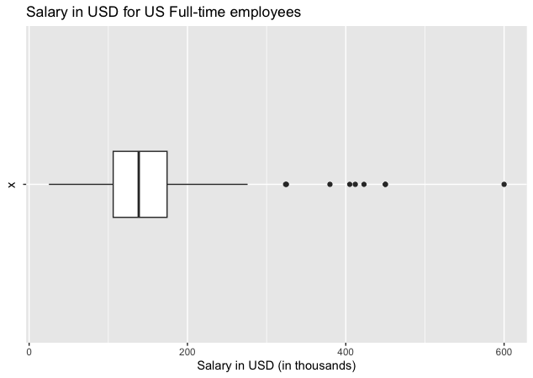
Summary Statistics for US Full-time Employees
Min: 25,000
1st Quartile: 106,195
Median: 138,475
Mean: 148,297
3rd Quartile: 174,250
Max: 600,000
IQR: 68,055
Notes:
This boxplot consists of full-time employees residing in the US, regardless of job title, company location, and company size.
The interquartile range (IQR) indicates the spread between the 1st and 3rd quartiles and is not affected by outliers. Therefore, we will use this statistic to help determine our target salary range for this data scientist position.
For US full-time employees, the IQR is $68,055 which means the middle of this data ranges from $106,195 (1st quartile) to $174,250 (3rd quartile). By using the IQR, we can exclude the minimum and maximum numbers since these are considered outliers.

Slide 4
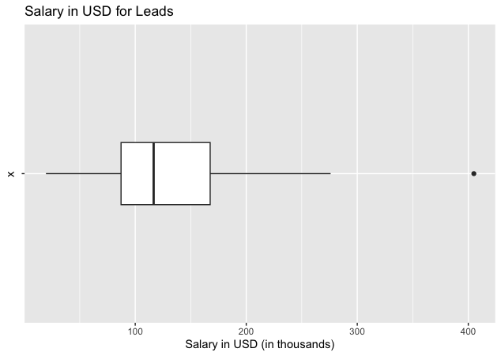
Summary Statistics for Leads
Min: 19,609
1st Quartile: 87,233
Median: 116,594
Mean: 139,533
3rd Quartile: 167,500
Max: 405,000
IQR: 80,267
Notes:
This boxplot consists of employees with the job title containing ‘Lead’ - some titles include Lead Data Scientist and Lead Data Engineer. The employees in this data happen to be full-time but their residence and company location is not filtered.
For Leads, the 1st quartile is $87,233 and 3rd quartile is $167,500 indicating the IQR is $80,267. This range compared to the one for US full-time employees is slightly wider and indicates the pay for ‘Lead’ job roles has greater variation. On the next slide, I’ll show the breakdown of each employee residence by average salary.

Slide 5
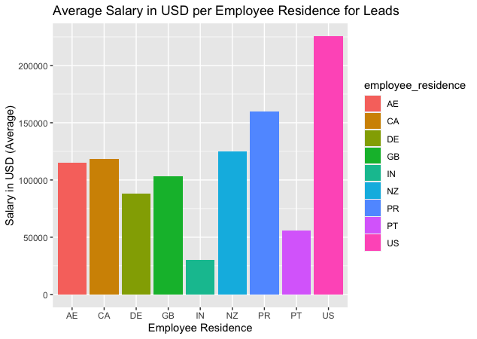
Notes:
As shown in the bar chart, the average salary for ‘Lead’ employees residing in the US is much higher than the international locations. From this, we can determine the IQR is most likely influenced by the international locations and therefore, bringing in a wider spread. On next the slide, the boxplot shows the Leads residing in the US.

Slide 6
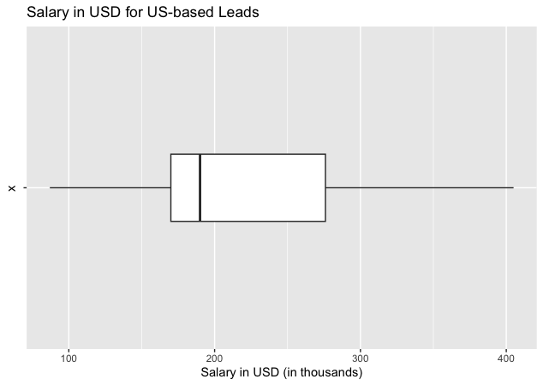
Notes:
In this boxplot, the 1st quartile is $170,000 and the 3rd quartile is $276,000 which means the IQR is $106,000. While the spread is still considered to be wide, the 1st and 3rd quartiles are much higher than the previous quartiles that included the international locations. Therefore, we can conclude the possible salary range should be between approximately $170k to $270k for this Lead Data Scientist position located in the US.

Slide 7
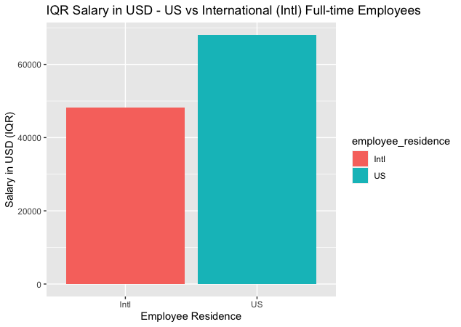
Onsite vs Offshore Employment
1st Quartile
US: 106,195
Intl: 40,408
3rd Quartile
US: 174,250
Intl: 88,654
IQR
US: 68,055
Intl: 48,246
Notes:
The IQR for US full-time employees is slightly higher than for the International employees. While the salary range for International employees is lower compared to the US, there could be more benefits to having an onsite employee compared to an offshore one.
It’s easier to communicate with others who are in the office or at least in the same time zone. It’s beneficial to collaborate as a team in-person and since we want this Data Scientist to be leading a team in future, in-person or partially remote would be helpful to create team bonding and focus on tasks together.

Slide 8
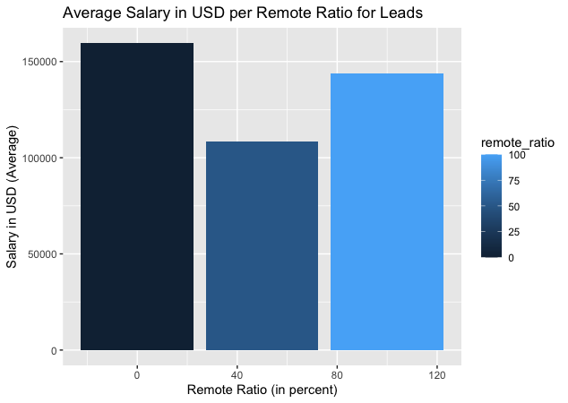
Notes:
As shown in the bar plot, the average salary differs only slightly between the 3 remote ratios: no remote work (less than 20%), partially remote (between 20% and 80%), and fully remote (more than 80%). Therefore, partially remote work could be acceptable for this role since the variation is not extreme.

Slide 9
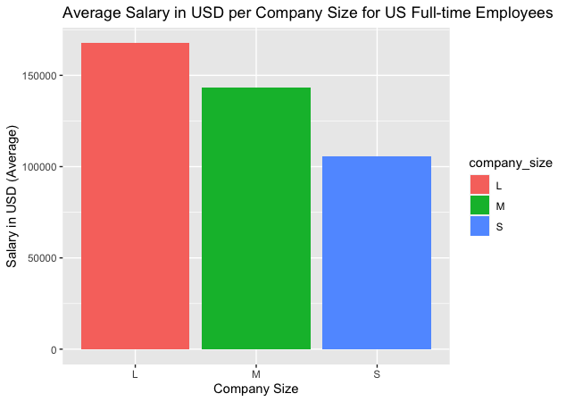
Notes:
As our company expands, the salary for this Data Scientist will likely increase over time based on how well the company is doing, individual performance, etc. We would like to incentivize this person to grow with the company and build their own data science team. As evidenced in this slide, the average salary slightly varies between small, medium and large companies. We should continue to evaluate our offering salaries to be on par with competitors and the market.

Slide 10
Recommendation
Based off this analysis, I recommend we hire an Intermediate Senior-Level Lead Data Scientist. This position should be based in the United States with flexibility to be remote up to 50% of the time. Based on qualifications and factors such as experience, we can expect to offer this person a salary range of $170k to $270k. As our company continues to expand, this person should strive to build their own team and their compensation will be in line with the company’s growth and market value.

